Slide 1
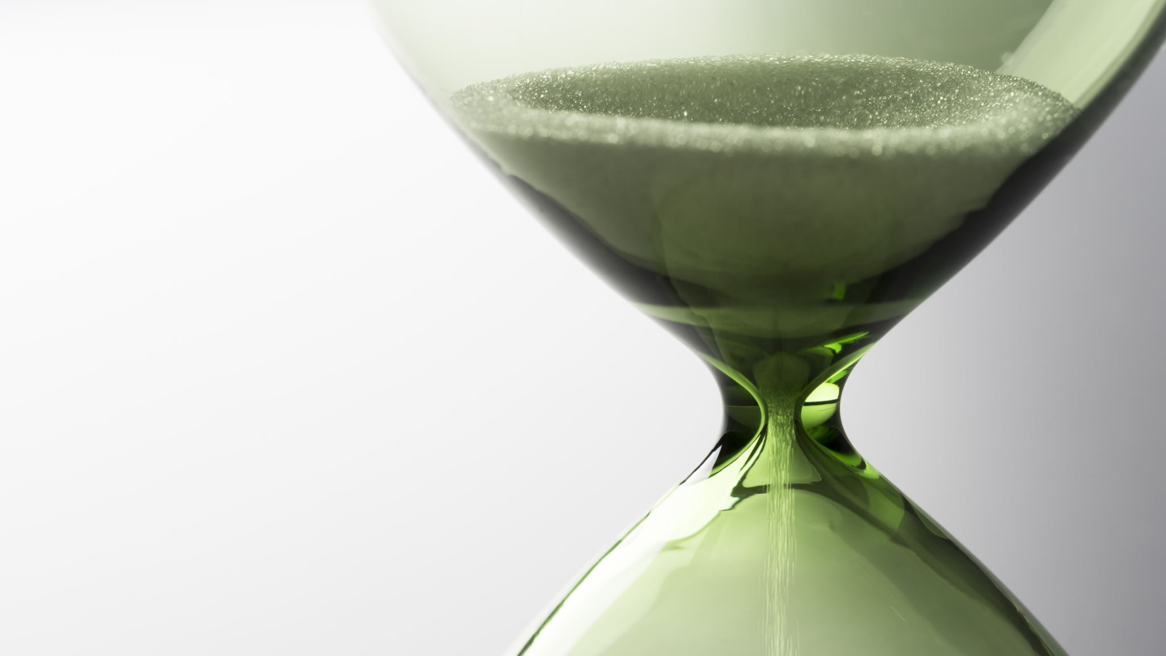
Time Complexity
Jun 18th 2020
By Alexander Joslin

Slide 2
Big O notation
Big O notation describes how time scales with respect to size.

Slide 3
Big O notation
list = [1, 4, 5, 2, 9, 5, 6, 3, 8, 3]
list[4]
Time complexity is
O(1)

Slide 4
Big O notation
list = [1, 4, 5, 2, 9, 5, 6, 3, 8, 3]
for i in list: print(i)
Time complexity is
O(n)

Slide 5
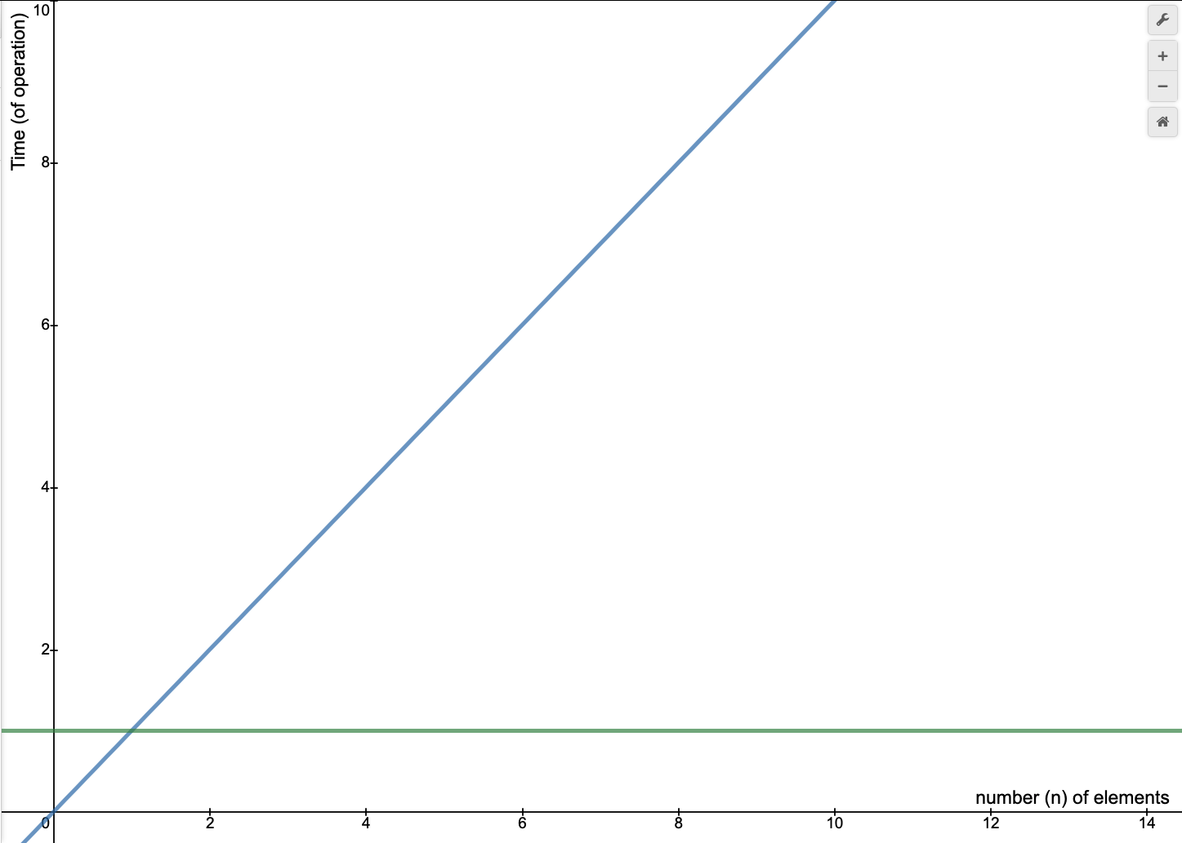
Graphing Time Complexity
O(n)
O(1)

Slide 6
Big O notation
list = [1, 4, 5, 2, 9, 5, 6, 3, 8, 3]
for i in list: for j in list:
print(j*i)
Time complexity is
O(n²)

Slide 7
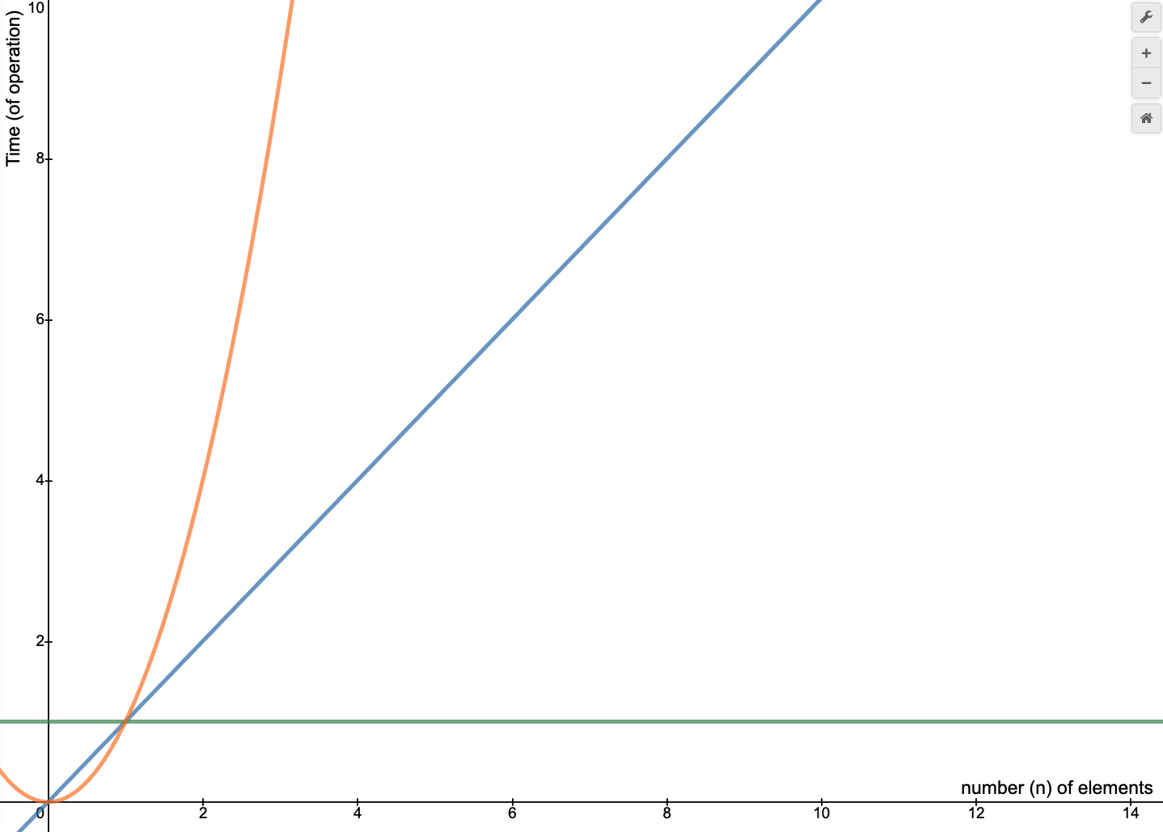
Graphing Time Complexity
O(n²)
O(n)
O(1)

Slide 8
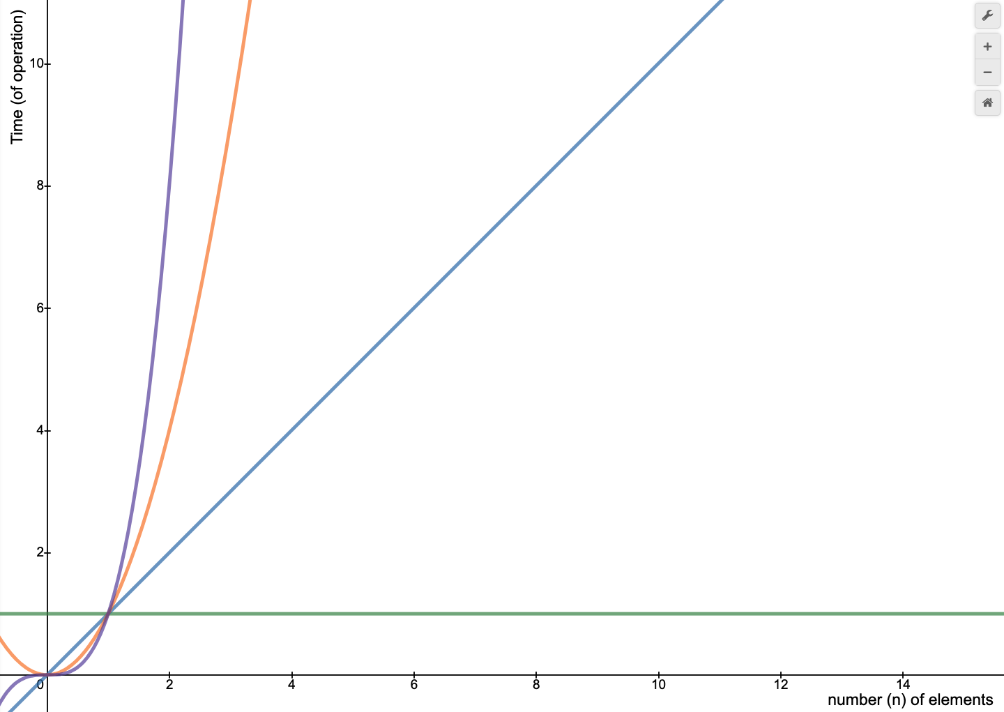
Common Time Complexities
O(1) “Constant Time”
It does not matter how large the input is, the runtime of that algorithm stays the same.
O(n³)
O(n²)
O(n)
O(n) “Linear Time”
Most common.
Time depends on how large your input is.
Ex: looping through a list.
O(n²) “Quadratic Time”
Ex: looping through a list with a nested for-loop.
Ex: bubble sort, selection sort, insertion sort
O(1)
O(n³) “Cubic Time”
Ex: looping through a list with triple nested for-loop.

Slide 9
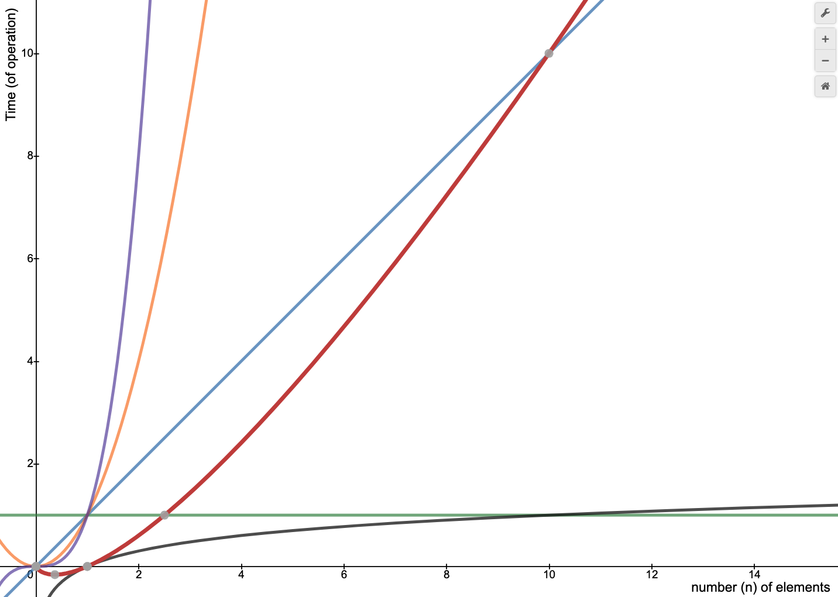
Common Time Complexities
O(log n) “Logarithmic Time”
Algorithms that half the number of steps needed at each iteration to get to a goal.
Cuts things in half
Ex: Binary Search Trees
Ex: n = 16, goal is 1
16 8 4 2 1 (4 steps to get to 1)
O(n³)
O(n²)
O(n log n)
O(n)
O(n log n) “Linearithmic time"
Ex: Merge Sort
Ex: Quick Sort
O(log n)
O(1)

Slide 10
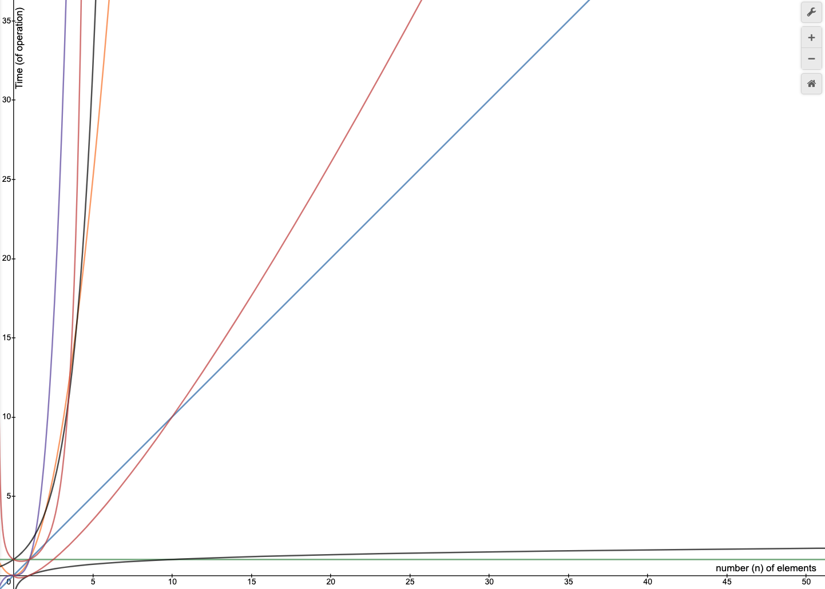
Common Time Complexities
O(n!)
O(n²)
O(n log n)
O(n)
O(2^{n}) “Exponential Time”
Ex: Backtracking Problems
Ex: Subsets
Ex: Recursion (Fibonacci sequence)
O(2^{n})
O(n³)
O(n!) “Factorial time”
Ex: Permutations
Find all the possible combinations of the word “cat”
cat, act, tac, cta, act ...
O(log n)
O(1)

Slide 11
Common Time Complexities
Best to Worst
O(1)
O(log n)
O(n)
O(n log n)
O(n²)
O(n³)
O(2^{n})
O(n!)

Slide 12
Example
What is the Time Complexity?
nums1 = [4, 5, 7, 6, 2] nums2 = [3, 6, 1, 0, 0, 7, 4] total = 0 for i in nums1 : total += i for j in nums2 : total += j print(total)
Rule # 1
Different Steps get added.
Answer: O(n + k)

Slide 13
Example
What is the Time Complexity?
nums1 = [4, 5, 7, 6, 2] total = 0 for i in nums1 : total += i for j in nums1 : total += j print(total)
Rule # 2
Drop Constants
Answer: O(n)

Slide 14
Example
What is the Time Complexity?
nums1 = [4, 5, 7, 6, 2] nums2 = [3, 6, 1, 0, 0, 7, 4] count = 0 for i in nums1: for j in nums2: if i == j: count += 1 print(count)
Rule # 3
Different inputs require
different variables.
Answer: O(n * k)

Slide 15
Example
What is the Time Complexity?
nums1 = [4, 5, 7, 6, 2] for n in nums1: print(n) for i in nums1: for j in nums1: print(j)
Rule # 4
Drop non-dominate terms.
Answer: O(n²)

Slide 16

Practice Example 1
list = [1, 4, 5, 2, 9, 5, 6, 3, 8, 3]
Time complexity is
O(n²)
n = len(list)
for i in range(int(n/2)):
for j in range(int(n/2)):
print(list[i] + list[j])
Explanation:
$$\frac{1}{2}n∗\frac{1}{2}n = \frac{1}{4}n^{2}$$
Rule 2: drop constants
$$O(n^{2})$$

Slide 17

Practice Example 2
Time complexity is
O(n)
def is_palindrome(word): x = 0 y = len(word)-1 while x < y: if word[x] != word[y]: return False x += 1 y -= 1 return True print(is_palindrome("racecar"))
Explanation:
Looping $\frac{1}{2}n$ times.
Rule 2: drop constants
$$O(n)$$

Slide 18

Practice Example 3
Time complexity is
O(n²)
list = [1] n = len(list) for i in range(n*n): item = list[0]
Explanation:
Looping $n^{2}$ times.
$$O(n^{2})$$

Slide 19

Practice Example 4
Time complexity is
O(log(n))
n = 64 squares = 0 while n > 1: squares += 1 n = n/2 print(squares)
Explanation:
Cutting n in half with every loop.
$$O(log⁡(n))$$

Slide 20

Practice Example 5
Time complexity is
O(n)
list = [6,4,3,0,5,2,7,2,1,9] if 5 in list: print("5 was found")
Explanation:
in keyword in python loops through the list in order to check if 5 is there.
$$O(n)$$
Note this is the case for lists but for dictionaries and sets, the ‘in’ keyword has a time complexity of O(1).

Slide 21

Practice Example 6
Time complexity is
O(n*k)
list = [“abc”, “crv”, “mkd”, “lvx”, “rty”] for string in list: for i in string:
print(i)
Explanation:
n = length of list
k = length of string
$$O(n∗k)$$

Slide 22

Practice Example 7
Time complexity is
O(1)
def show_ruler(): INCHES_IN_FOOT = 12 for num in range(INCHES_IN_FOOT+1): print(f'{num}!!|!!', end="") show_ruler()
Explanation:
There will always be 12 inches in a foot making 12 is a constant value which makes the time complexity constant.
$$O(1)$$
Output:
0!!|!!1!!|!!2!!|!!3!!|!!4!!|!!5!!|!!6!!|!!7!!|!!8!!|!!9!!|!!10!!|!!11!!|!!12!!|!!

Slide 23
Best, Average, Worst Case
Time Complexity is typically categorized by 3 cases;
Best Case, Average Case, and Worst Case
Example: Searching for an element in a list.
Best Case: O(1) (If the element you are looking for is at the beginning of the list.)
Average Case: O(n)
Worst Case: O(n)

Slide 24
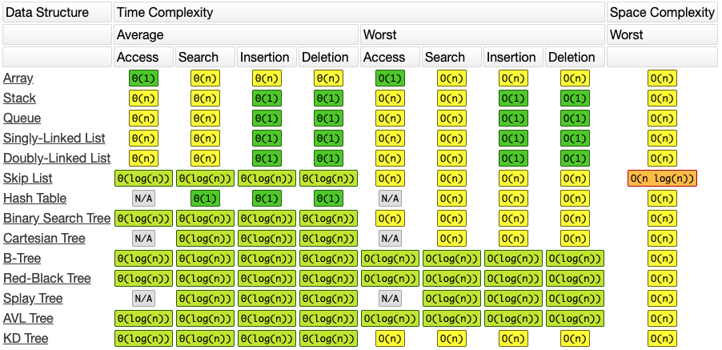
Common Data Structure Time Complexities
(It could differ. It really all depends on how you implement these Data Structures)
Ex: Implementing a stack in Python Vs in Java.
In Python you would use a List where in Java you might use an Array.

Slide 25
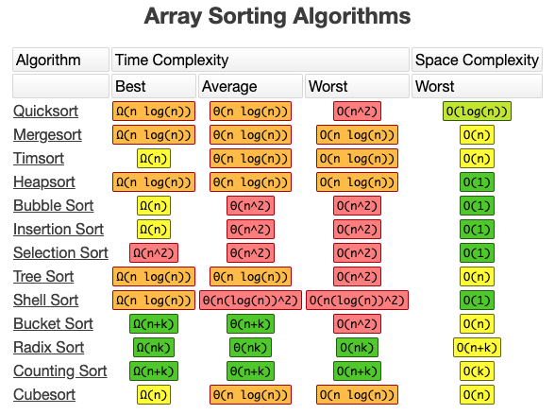
Array Sorting Algorithms Time Complexities

Slide 26
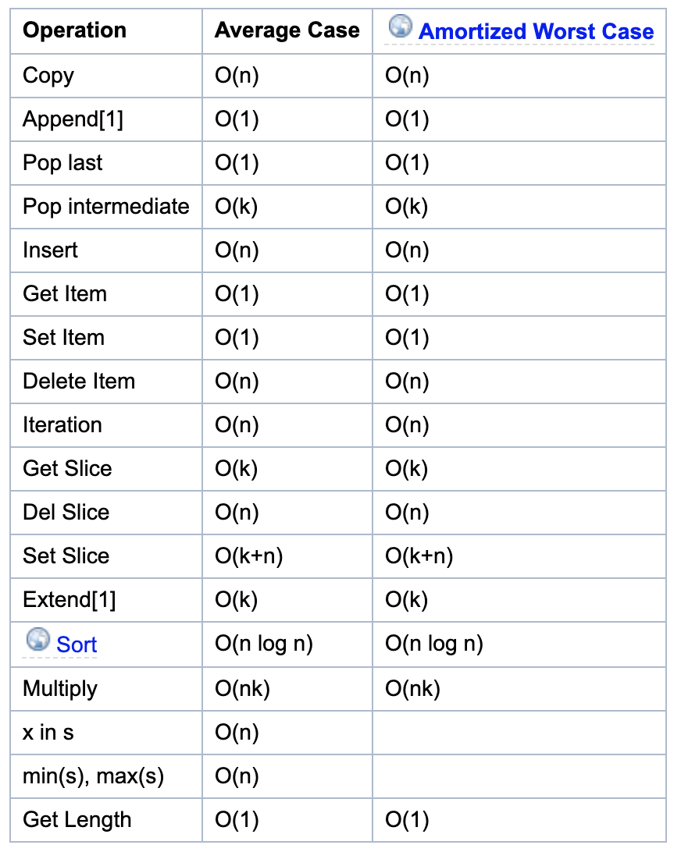
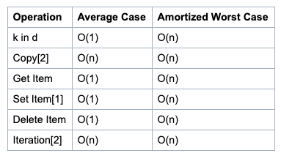
Python List Time Complexity
Dictionary Time Complexity
nums = []
for i in range(500000): nums.insert(0, 10)
Took 94.6 seconds.
nums = []
for i in range(500000): nums.append(10)
Took 0.061 seconds.
“Generally, 'n' is the number of elements currently in the container.
'k' is either the value of a parameter or the number of elements in the parameter.”

Slide 27
Space Complexity
We can also use Big O to describe an algorithm’s Space Complexity.
Space Complexity is the memory required by an algorithm to execute.

Slide 28
Example
Searching for an element in a list.
We know the average time complexity for this is O(n), but what would be the space complexity?
i
4
4 5 7 6 2 9 1 2
nums1 = [4, 5, 7, 6, 2, 9, 1, 2] for i in nums1: if i == 9: print("Found") break
As we are looping the variable “i” is
storing each element in memory
temporarily. Only one number is in
memory at a time.
Answer: O(1)

Slide 29
Time Complexity Vs Space Complexity
There is always a direct battle between the too.
When Time Complexity gets better, Space Complexity gets worse.
When Space Complexity gets better, Time Complexity gets worse.
In some hardware systems where space is very limited, space complexity is more important.
In software for self driving cars for example, Time Complexity is critical.

Slide 30
Time Complexity Vs Space Complexity
Which is more important? If you had to choose.
Time Complexity
The idea is we can always buy more memory, but we can never buy more time.

